Slide 1
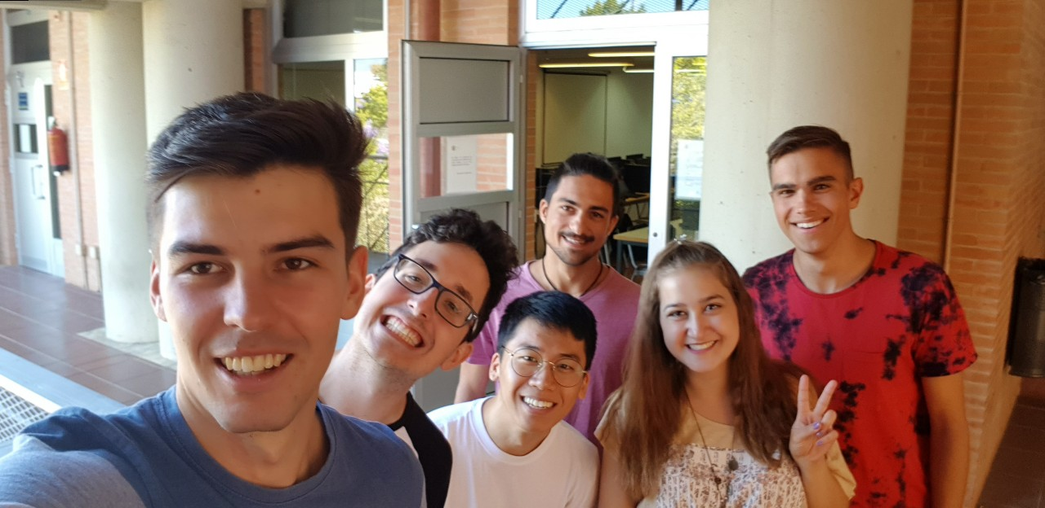

Introduction to Software Engineering
1
HALKIDIKI PetsApp
Introduction to Software Engineering - Final Presentations

Slide 2
Introduction(1/2)
2
An app that help pets and their owners in the following categories:
Hospitality & Adoptions
Finding new home for ownerless pets – either temporary or permanent
Lost & Found pets
Connecting owners who lost their pets with people who found them
Introduction to Software Engineering - Final Presentations
Notes:
2

Slide 3
Introduction(2/2)
3
An app that help pets and their owners in the following categories:
PetSitting
Finding people who will take care of a pet when it’s owner can’t do it
Rewards
When they contribute, users get rewards: food and accessories for pets
Introduction to Software Engineering - Final Presentations
Notes:
3

Slide 4
Team and teamwork (1/2)
4
Name of the team : Halkidiki
Client :
Antonio Maña Gómez
Team members :
Sanggil Han
Michał Mazurkiewicz
Konstantina Marantidou
Antoni Pięta
Adrián Salas Troya
George Karamalis
Introduction to Software Engineering - Final Presentations
Notes:
4

Slide 5
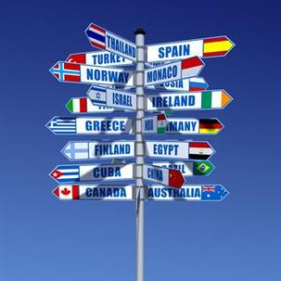
Team and teamwork (2/2)
5
We are a group of 6 people from different countries -> different cultures -> problems
We did the best effort that we could to solve the problems in our coordination and work together like a team until the end.
Some people tried more than other people but finally we have the project done.
Introduction to Software Engineering - Final Presentations
Notes:
5

Slide 6
Solution
6
Proposed solution
Developing a social app/web to share resources and help pets and owners
Collaborative aspects of the chosen approach
People can upload an animal's information they have found on a street
-So that other people who have interests can take care of them
-Or that the shelter can rescue them
People can help owners, taking care of their pets during holidays or when they can't
Contributors will be rewarded with resources which will help them with taking care of animals
Introduction to Software Engineering - Final Presentations
Notes:
6

Slide 7
Software Engineering Activities - Requirements
7
Commitments:
UI Design of web and android app
Backend of the app (Server-side):
Hospitality
Lost & Found
PetSitting
User Profiles
Database
Advertiser's requirement - smart advertisement system
Shelter's requirement - minimizing effort and time to find and take volunteers equally
Introduction to Software Engineering - Final Presentations
Notes:
7

Slide 8
Software Engineering Activities - Architecture
8
This is how it works in our application
USER
SUBSCRIBER
USER
PUBLISHER
addPost();
POSTMANAGER
USER
SUBSCRIBER
USER
PUBLISHER
getNotificationsForAPost();
USER
SUBSCRIBER
USER
PUBLISHER
NOTIFICATION
MANAGER
sendNotification();
USER
SUBSCRIBER
Introduction to Software Engineering - Final Presentations
Notes:
8

Slide 9
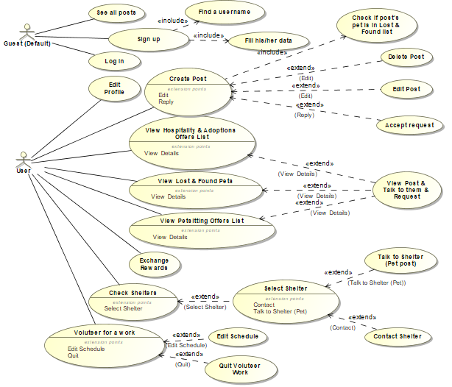
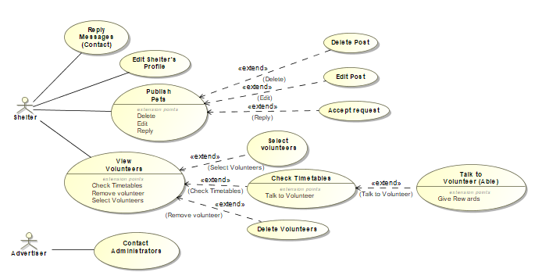
Software Engineering Activities – Models(1/3)
9
UML Use-Case (Road Map)
Introduction to Software Engineering - Final Presentations
Notes:
9

Slide 10
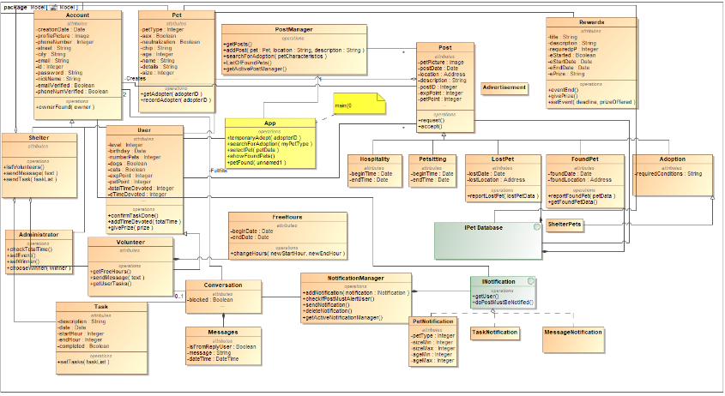
Software Engineering Activities – Models(2/3)
10
UML Class Model
Introduction to Software Engineering - Final Presentations
Notes:
10

Slide 11
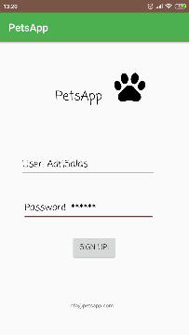
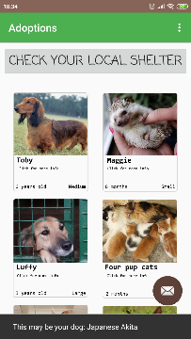
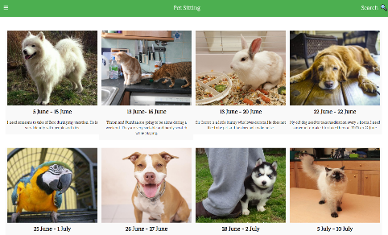
Software Engineering Activities – Models(3/3)
11
UI Design
Introduction to Software Engineering - Final Presentations
Notes:
11

Slide 12
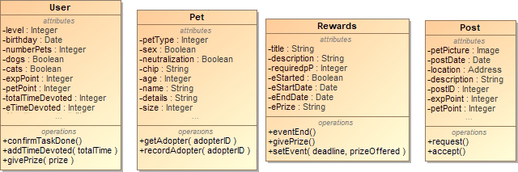
Software Engineering Activities – Principles
12
Single Responsibility Principle
Every class has a role in the system
Every class has one reason to change
Introduction to Software Engineering - Final Presentations
Notes:
12

Slide 13
Software Engineering Activities – Patterns
13
Singleton
- The Manager classes need to instantiate only once. - There must be only one User per session.
Façade
- Classes like Post and Account are facades, consisting of other classes.
Introduction to Software Engineering - Final Presentations
Notes:
13

Slide 14
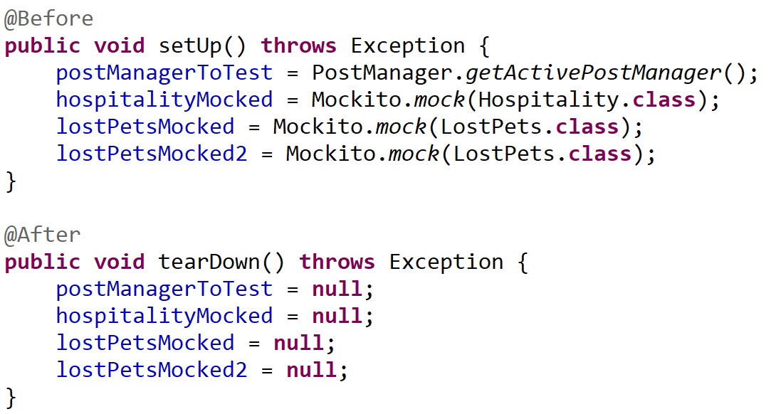
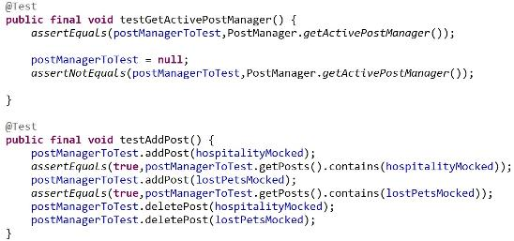
Software Engineering Activities – Testing
14
Introduction to Software Engineering - Final Presentations
Notes:
14

Slide 15





Development / Deployment
15
Strategies & Tools
1. Write Test
5. Refactor
2. Test Fails
TDD
4. Test Passes
3. Write Code
Introduction to Software Engineering - Final Presentations

Slide 16
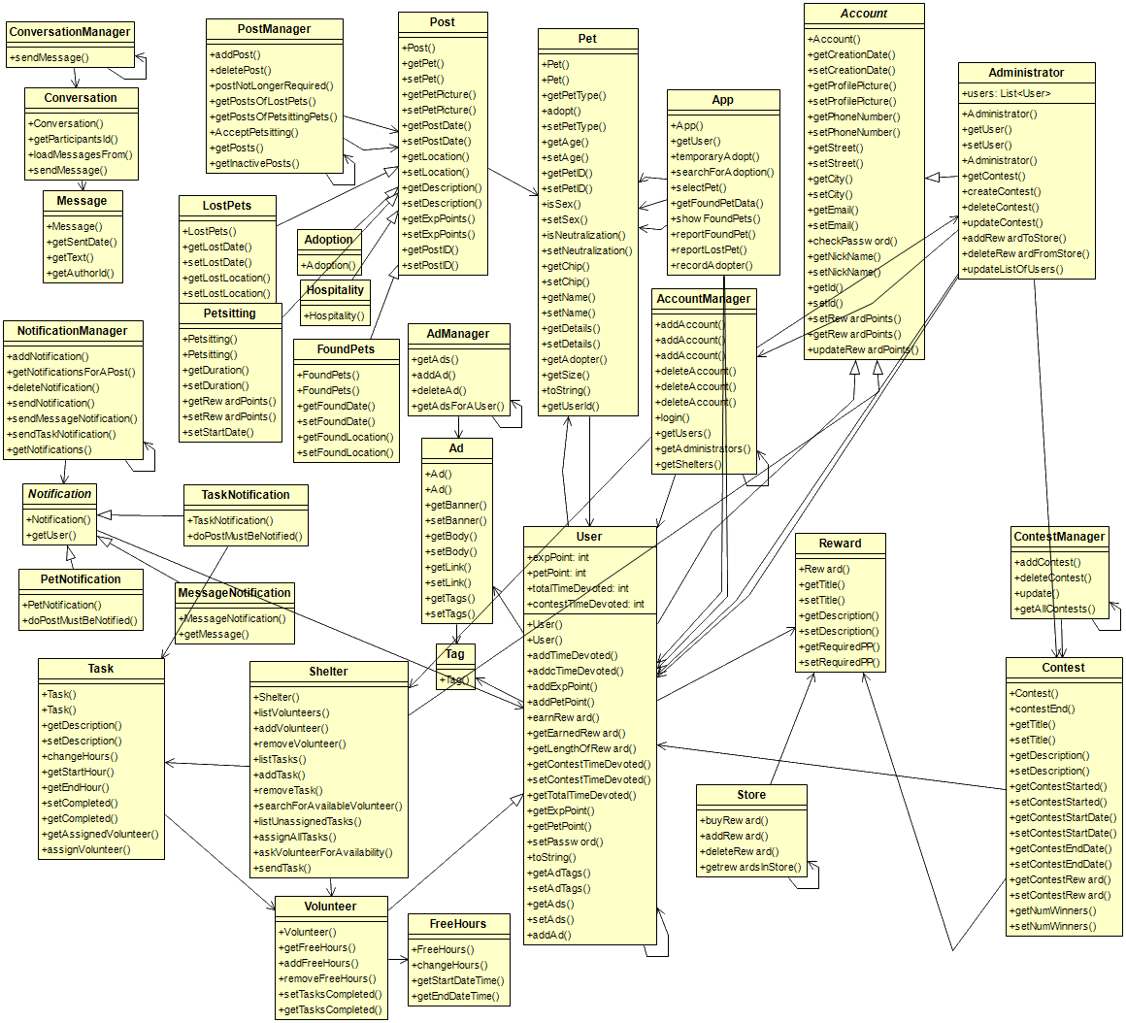
Implementation Models
16
Introduction to Software Engineering - Final Presentations
Notes:
16

Slide 17
Results
17
Application which can help Animals!
Functionalities for many problems:
Petsitting
LostPets
FoundedPets
Hospitality
Reward system! Help and get discount!
Code covered by unitTests!
Documentation created by unitTests and UML diagrams
Introduction to Software Engineering - Final Presentations
Notes:
17

Slide 18
Conclusion
18
What we have learnt:
What will happen to people who work as a team.
How developers deal with requirements.
How to use Git Hub.
How to use Magic Draw(UML – User Case Diagram, Class Diagram, Sequence Diagram).
How to use JUnit.
How to use Mockito.
How to code based on Test Driven Development. (TDD)
How to manage problems of communication.
How hard coding is.
Introduction to Software Engineering - Final Presentations
Notes:
18

Slide 19

Q&A
19
Introduction to Software Engineering - Final Presentations

